Slide 1



Design and Validation of a Constant Wall Temperature Plate
Drummond Biles Advisor: Chris White
University of New Hampshire
APS-DFD
24 November 2014
Special Thanks to:
Michael Allard, Allen Ma, and Reza Ebadi
THIS WORK IS SUPPORTED BY AN NSF/DOE PARTNERSHIP
AWARD’S: 1258702, 1258594, 1258697

Slide 2

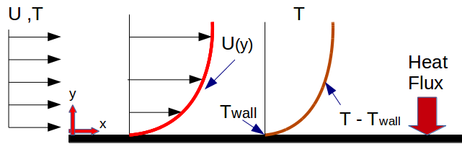
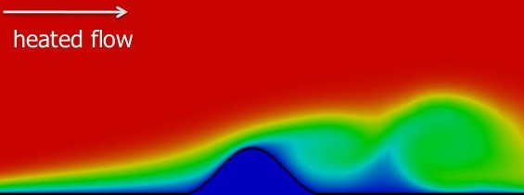
Non-Equilibrium Thermal Boundary Layers
Equilibrium Boundary Layer
Non-Equilibrium Boundary Layers brought about from;
.,. Pressure gradients
.,. Separation
.,. Dynamic walls
.,. Unsteady flow
In many engineering applications one or several of these effects are important
VACC, UVM

Slide 3

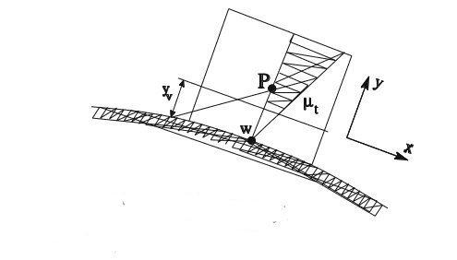
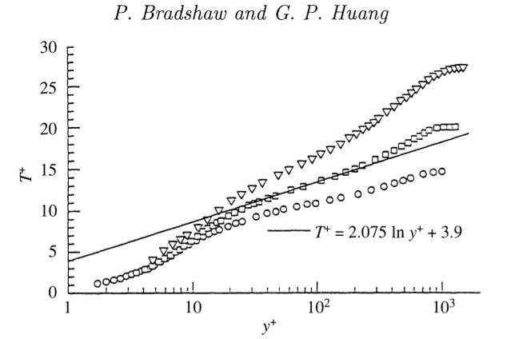
CFD Wall models (Equilibrium Flows)
.,. Computationally expensive to solve near wall dynamics
.,. Near wall dynamics extrapolated from log profile
.,. Reasonable estimate for equilibrium wall flows
.,. Fail when applied
non-equilibrium boundary layers
Bradshaw et al., The law of the wall in turbulent flow

Slide 4
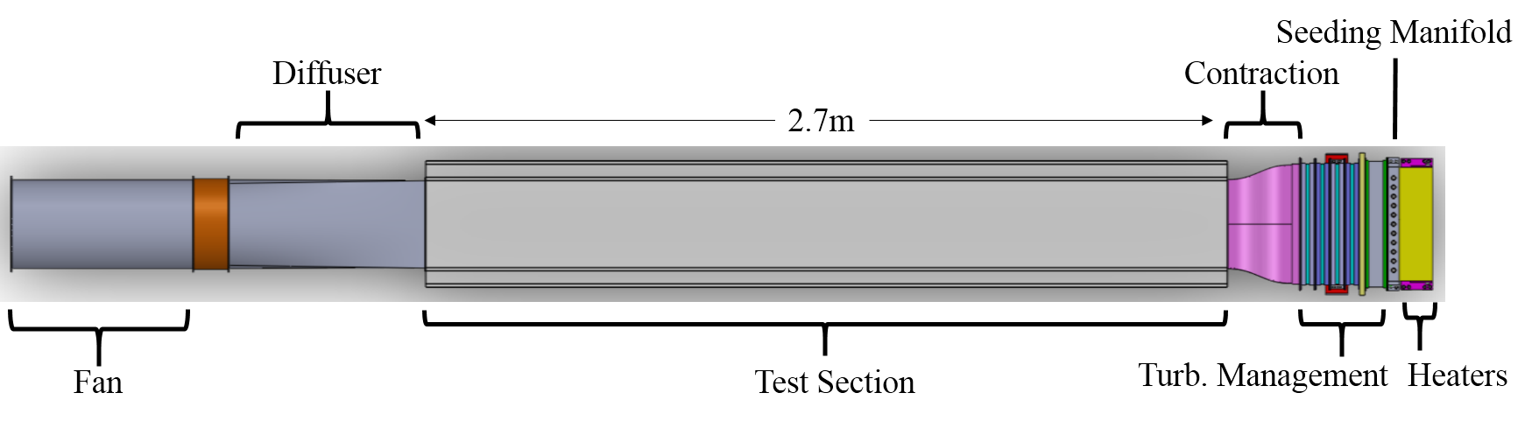
Experimental Approach
Systematic and Simple
Design Constraints
Facility
.,. Length=2.75m
.,. Control Boundary Conditions
.,. Turbulent Management section (screens/honeycomb)
.,. Velocity 0.25 to 12m/sec (frequency controlled motor)
-Control T
∞
-Control T_{o} /heat flux
.,. Maintain attached boundary Layer
UNH Thermal Boundary Layer Wind Tunnel

Slide 5

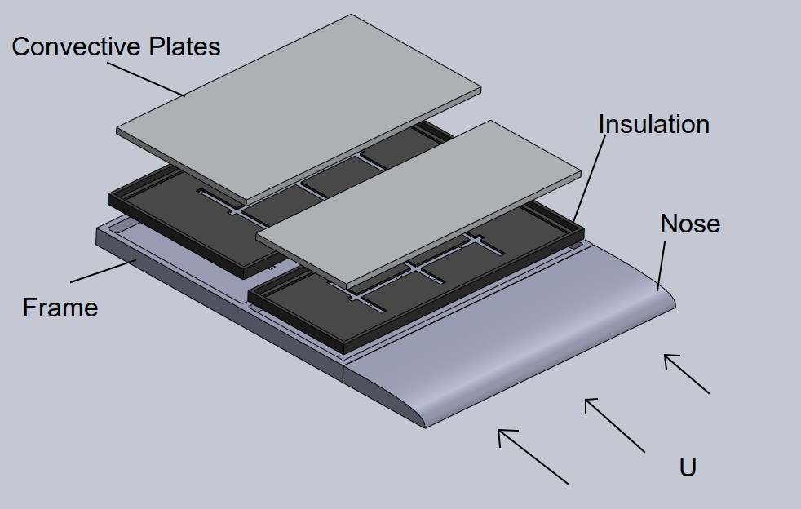
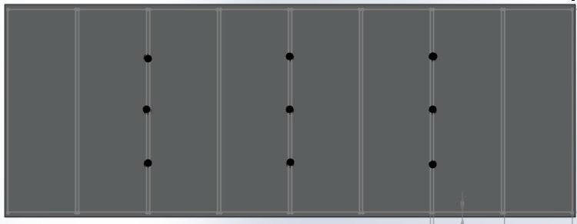
Prototype Sectioned Constant Wall Temperature Plate
.,. Size=0.45m x 0.65m
.,. Sectioned design∗
.,. Independently heated/controlled∗
.,. Individually Insulated
Front Convective Plate
* Blackwell, B. F., The turbulent boundary layer on a porous plate

Slide 6
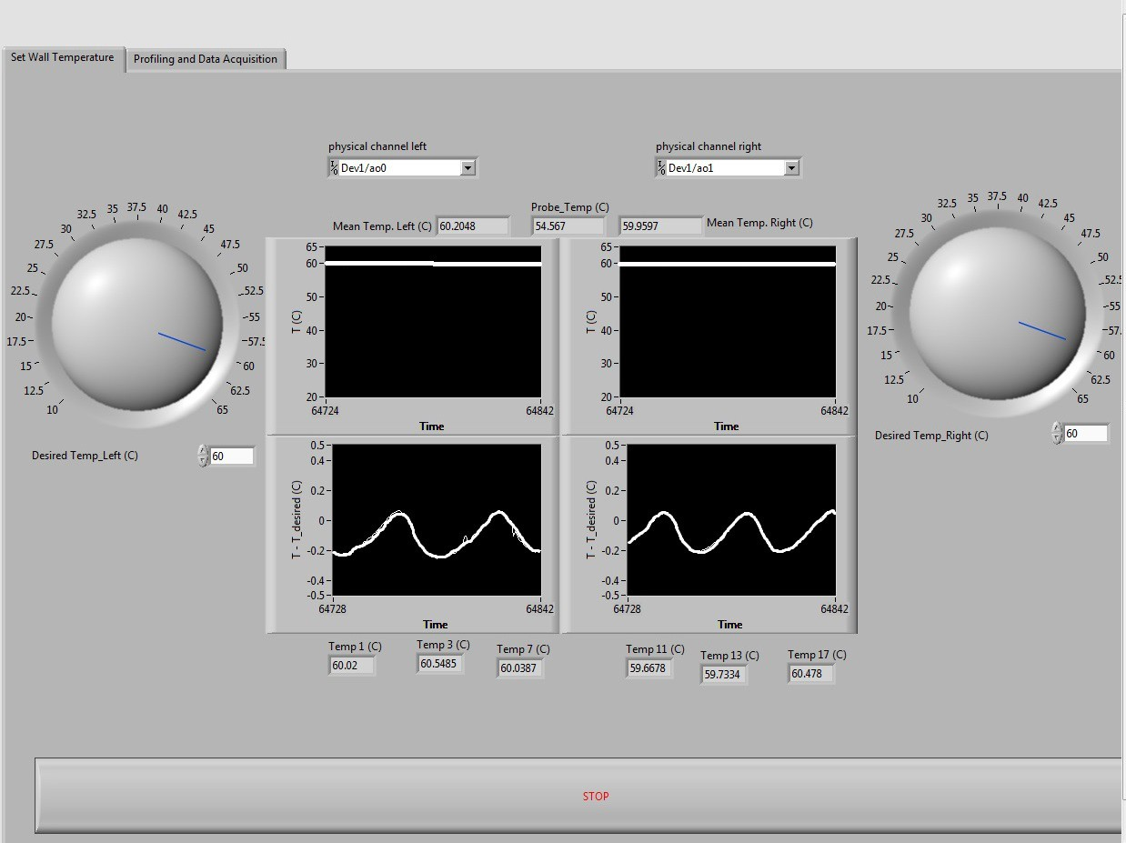
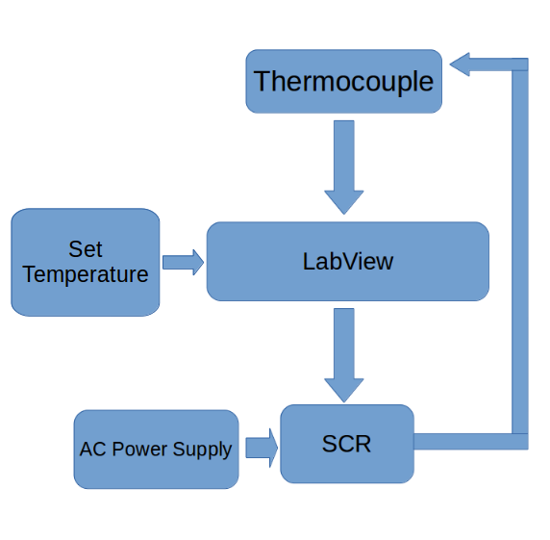
Temperature Controller
.,. Maintain temperature within + − 0.1º C
.,. Independently monitor and control each plate
Designed/Created by:Ebadi, Reza

Slide 7
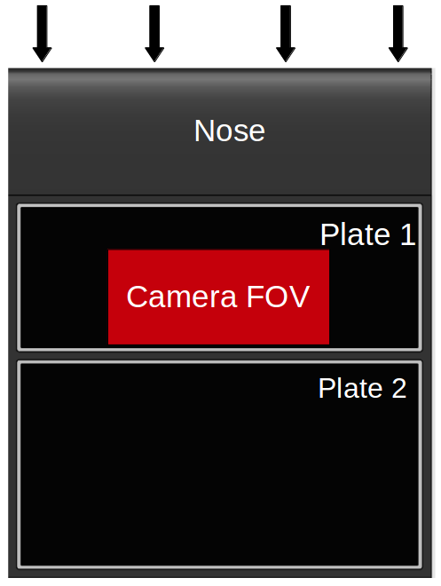
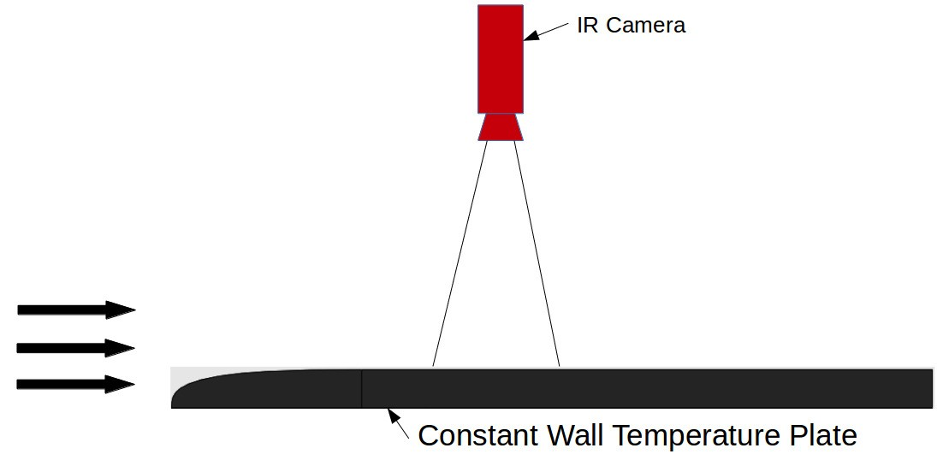
Spatial Temperature Distribution
7/14

Slide 8

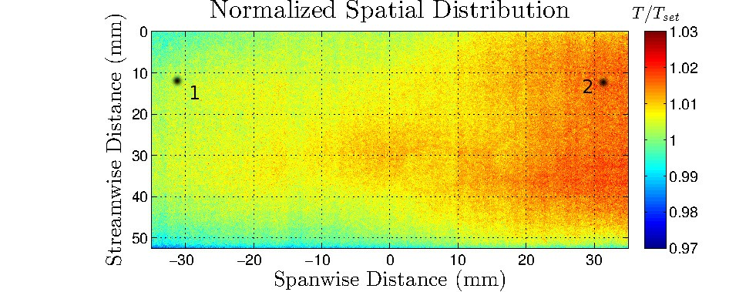
Spatial Temperature Distribution
Thermocouple #1 = 50º C Thermocouple #2 = 50.01º C
7/14

Slide 9

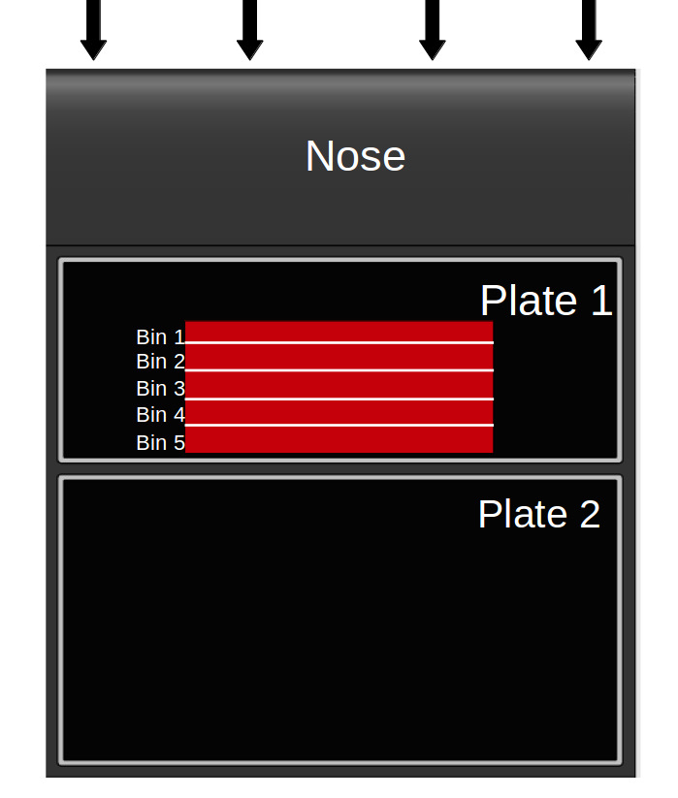
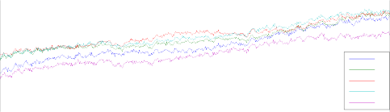
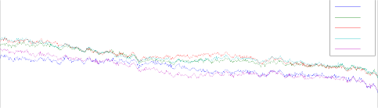
Spatial Temperature Distribution
Spanwise Profile
1.02
1.01
T/Tset
#1
#2
#3
#4
#5
1
0.99
−30
−20
−10 0 10
Spanwise Distance (mm)
Spanwise Profile (camera reversed)
20
30
#1
#2
#3
#4
#5
1.01
T/Tset
1
0.99
−30
−20
−10
0 10
20
30
Spanwise Distance (mm)

Slide 10

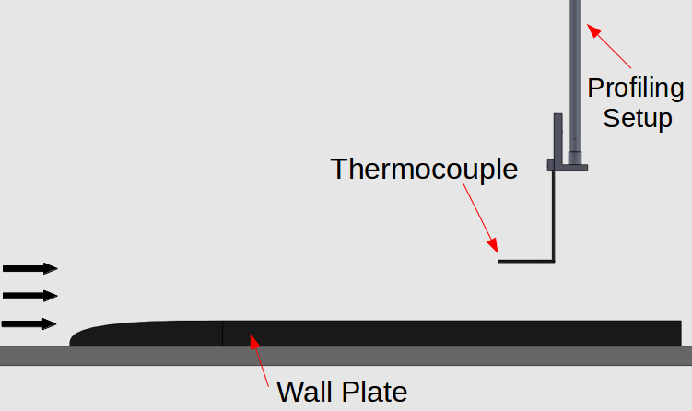
Temperature Profile
.,. Type K thermocouple
.,. Probe−diameter
= 0.0212
δ_{T}
.,. Downstream position=0.3 m
.,. Re = 5.7 ∗ 10⁴
.,. Wall temperature= 60º C
.,. 30 points logarithmicly spaced
.,. Sampled at 2 Hz for 2 min
9/14

Slide 11

Temperature Profile
Temperature Profile Comparison
Non-dimensional variables∗∗:
1
0.8
_{.,. θ =} T −T∞
θ
0.6
^{T}wall ^{−T}∞
.,. η_{T} = ^{y}
0.4
Analytical
δ_{T}
Experimental Confidence Interval
.,. θ_{A} = 1 − 1.5η + .5η³
0.2
0
−1
0
10
η_{T}
10
** Faghri, Amir, Advanced Heat and Mass Transfer
9/14

Slide 12

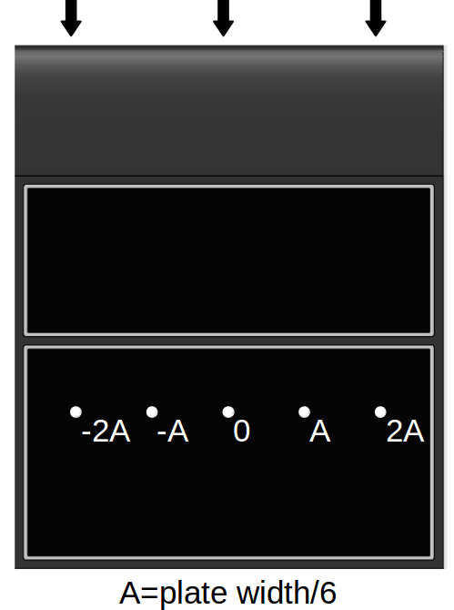
Spanwise Variability
Temperature Profile
50
−2A
−A 0 A 2A
Temperature (c)
40
30
20
0
0.005
0.01 0.015
Height (m)
0.02
0.025
10/14

Slide 13

Spanwise Variability
Normalized Temperature Profile
1
−2A
Temperature Profile
−A
50
0
A
2A
+−2STD
−2A
−A 0 A 2A
0.8
Temperature (c)
40
0.6
θ
30
0.4
20
0
0.005
0.01 0.015
Height (m)
0.02
0.025
0.2
0
₁₀−2
₁₀−1
η_{T}
10⁰
10/14

Slide 14
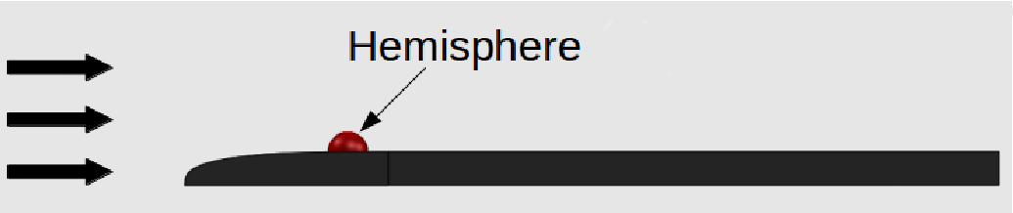
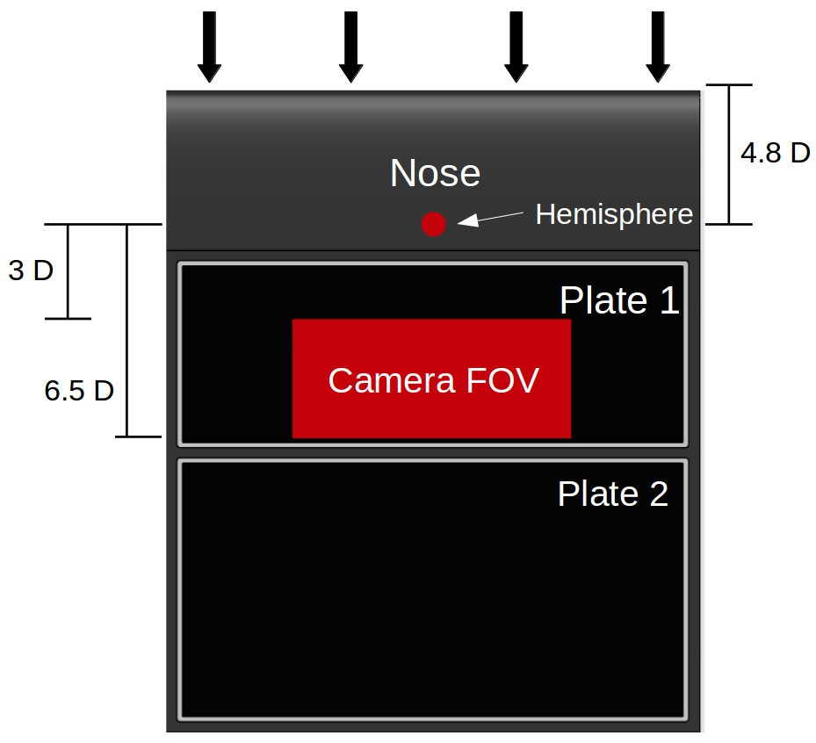
Single Perturbation
.,. 3cm Diameter
.,. Insulated
.,. D
_{δ} = 10
11/14

Slide 15


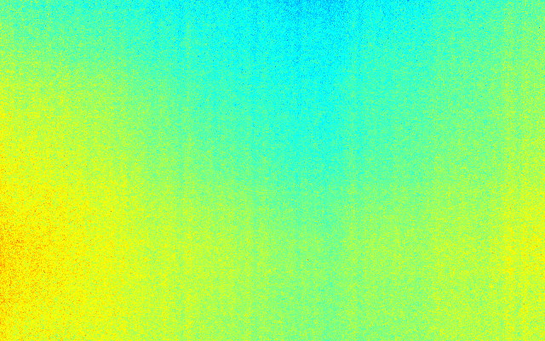
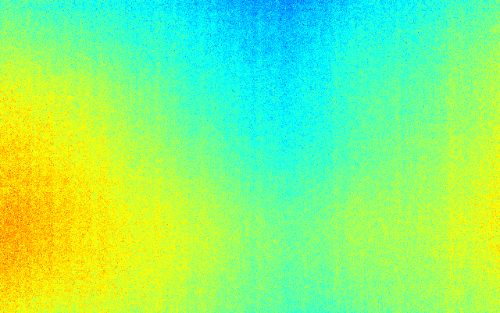
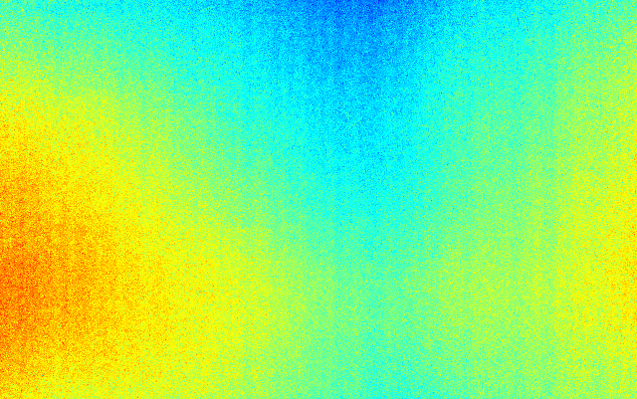
Single Perturbation
Set Temperature=30º C
R_{e} = 9.4 ∗ 10⁴
^{T/T}set
^{R}e ^{= 1.25 ∗ 105}
^{T/T}set
0
0
1.02
1.02
Streamwise Distance (mm)
50
1
Streamwise Distance (mm)
50
1
100
0.98
100
0.98
−50 0 50
R_{e} = 1.88 ∗ 10⁵
−50 0 50
R_{e} = 2.42 ∗ 10⁵
^{T/T}set
T/T
set
0
0
1.02
1.02
50
1
50
1
100
0.98
100
0.98
−50
0
50
−50
0
50
Spanwise Distance (mm)
Spanwise Distance (mm)
11/14

Slide 16

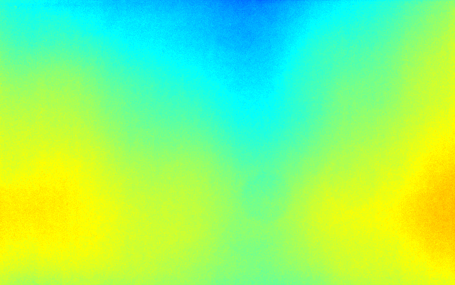
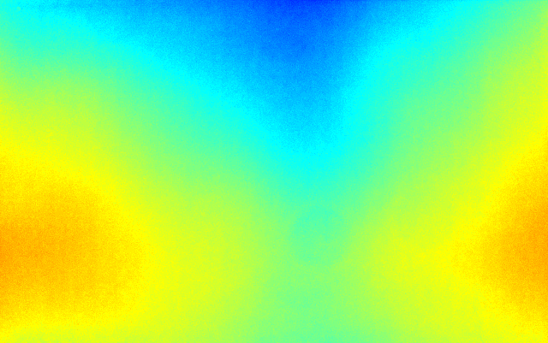
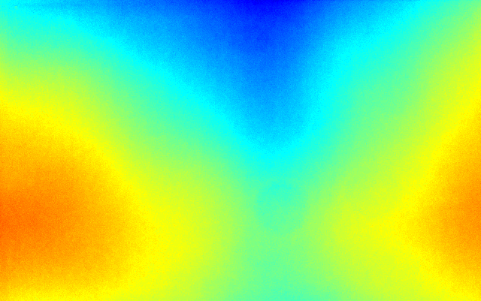
Single Perturbation
Set Temperature=60º C
R_{e} = 9.4 ∗ 10⁴
^{T/T}set
R_{e} = 1.25 ∗ 10⁵
^{T/T}set
0
20
40
60
80
100
1.05
0
20
40
60
80
100
1.05
Streamwise Distance (mm)
1
Streamwise Distance (mm)
1
−50 0 50
R_{e} = 1.88 ∗ 10⁵
0.95
−50 0 50
R_{e} = 2.42 ∗ 10⁵
0.95
^{T/T}set
T/T
set
0
1.05
0
20
40
60
80
100
1.05
50
1
1
100
−50
0
50
0.95
−50
0
50
0.95
Spanwise Distance (mm)
Spanwise Distance (mm)
11/14

Slide 17
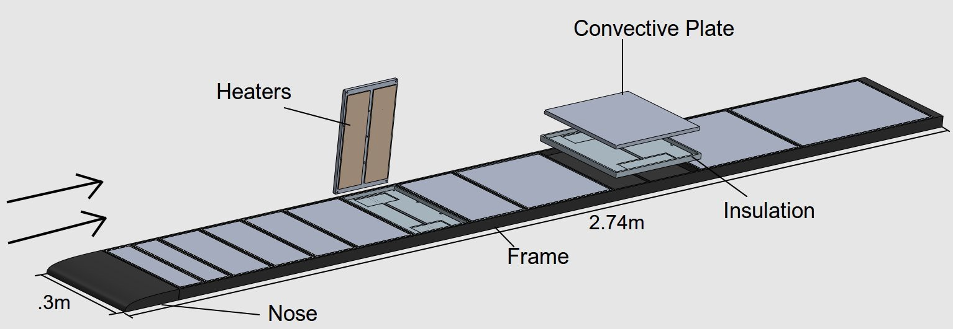
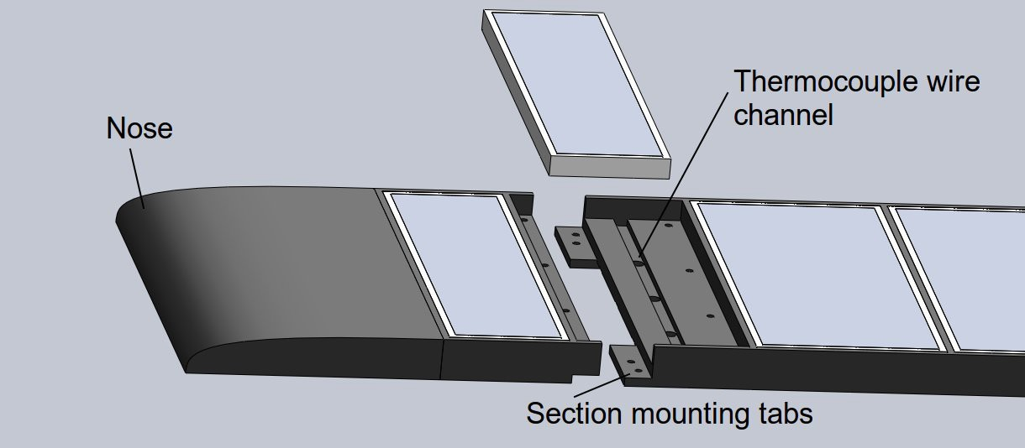
Final Wall Plate Design

Slide 18
Conclusions
.,. Control set temperature to +-.1º C
.,. In equilibrium flow produce spatially uniform temperature to +-2%
.,. Produce 2D equilibrium thermal boundary layer
.,. Develop spatial structure resulting from non-uniform heat flux
Future Work
.,. Construct/Validate final plate design
.,. Investigate disturbance due to pressure gradient
.,. Investigate flow over 3D obstacle
.,. Investigate rapid periodic forcing on mean flow
.,. Investigate disturbance due to multiple perturbations on mean flow

Slide 19

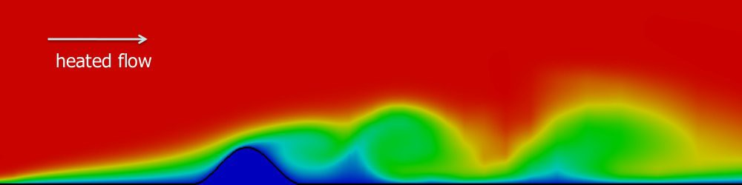
Questions??
VACC, UVM

